Slide 1
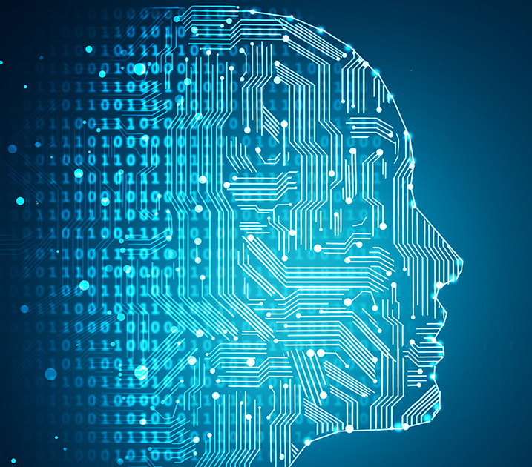
Human Action Recognition
Presented By
Umair Munir (03-134202-086)
Usman Jahangir (03-134202-088)
Syed Hamza (03-134202-084)

Slide 2
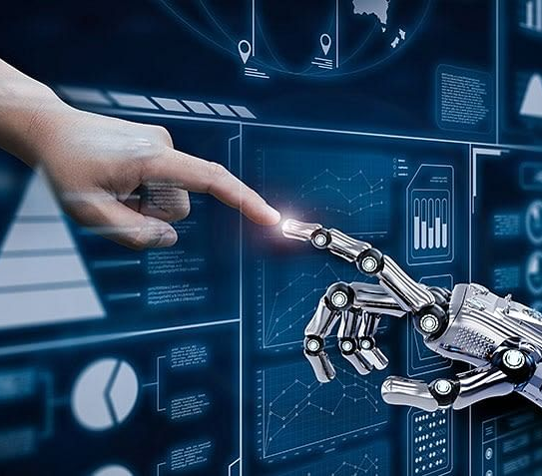
INTRODUCTION
Human action recognition systems are computer-based systems that use machine learning and computer vision techniques to analyze and interpret human movements and actions from input data like videos/images.
These systems preprocess the data, extract relevant features, and employ machine learning algorithms for action classification.
They have applications in surveillance, robotics, human-computer interaction, and sports analysis, allowing computers to understand and respond to human actions in various real-world scenarios.

Slide 3
OBJECTIVES
Accurately classify human actions.
Achieve real-time performance.
Enable natural human-computer interaction.
Recognize subtle and complex actions
Improve performance in crowded environments

Slide 4
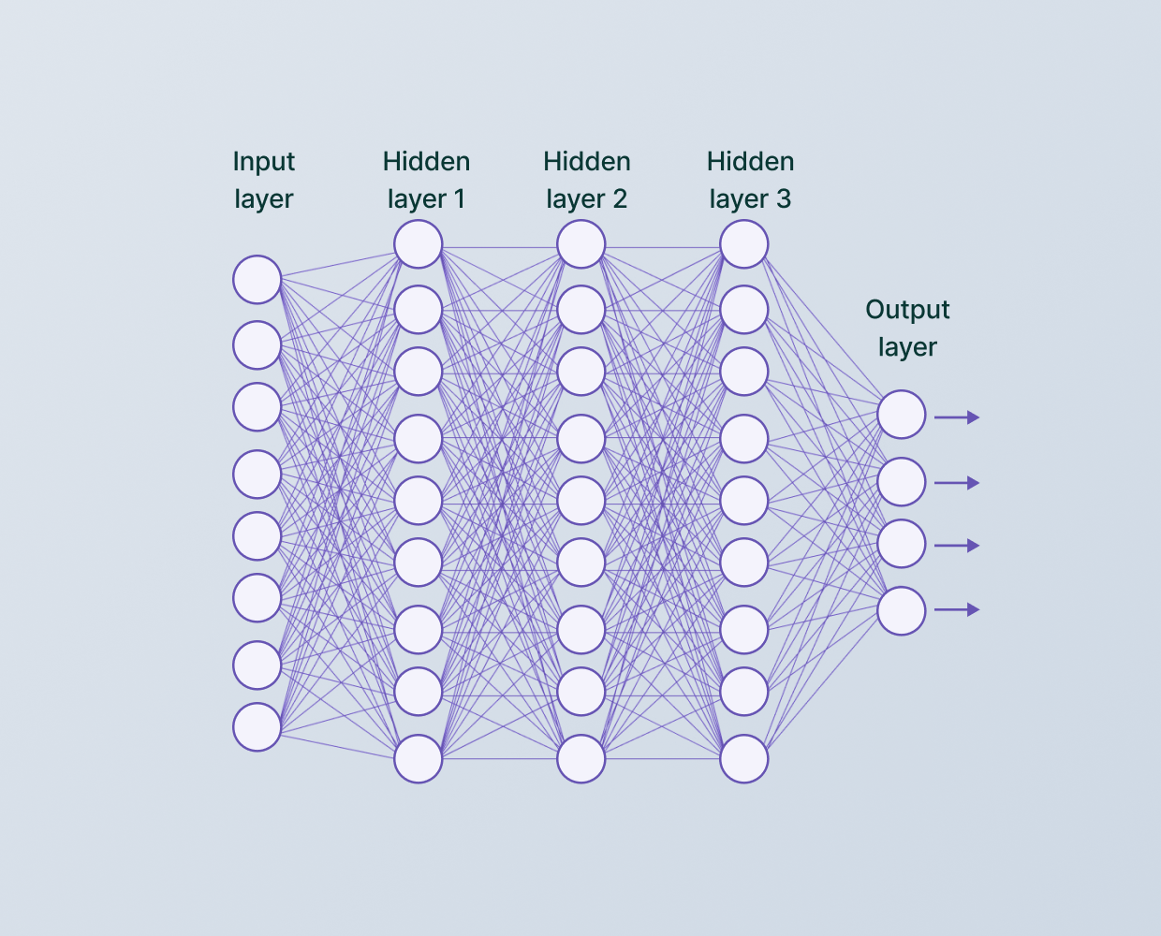
About Project
Name: Human Action Recognition
Model : Convolutional Neural Network
Working : Images as input. 1/15 responses output.

Slide 5




LIBRARIES INCLUDED

Slide 6
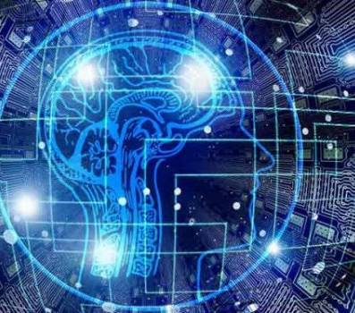
MODEL DETAIL
Number of Layers: 5
Epoch : 65
Batch Size: 394
Classes: 15

Slide 7
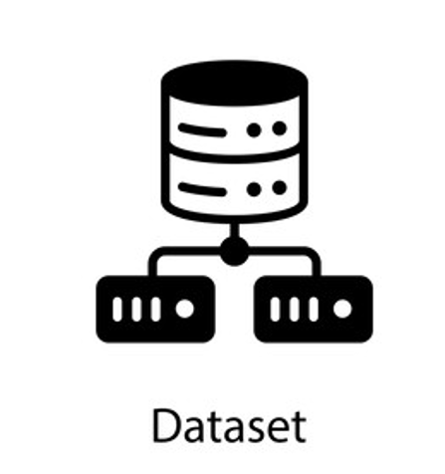
DATASET DETAILS
Data Set Size: ~311 MBs
Data Set Source: Kaggle
Data type: Images
Data Quantity: ~18000
Training: ~12000
Test: ~5000
Confusion Matrix: ~600

Slide 8
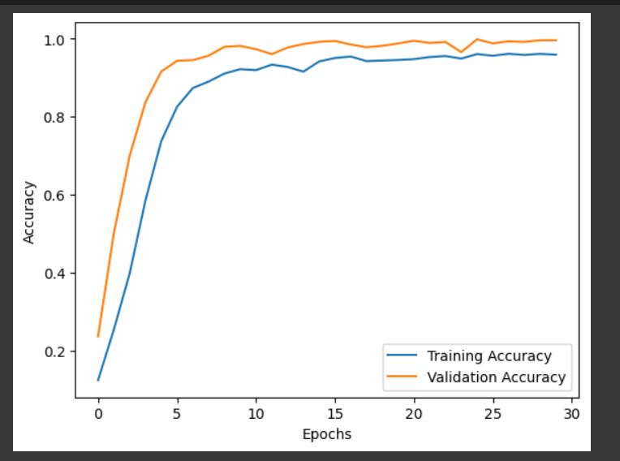
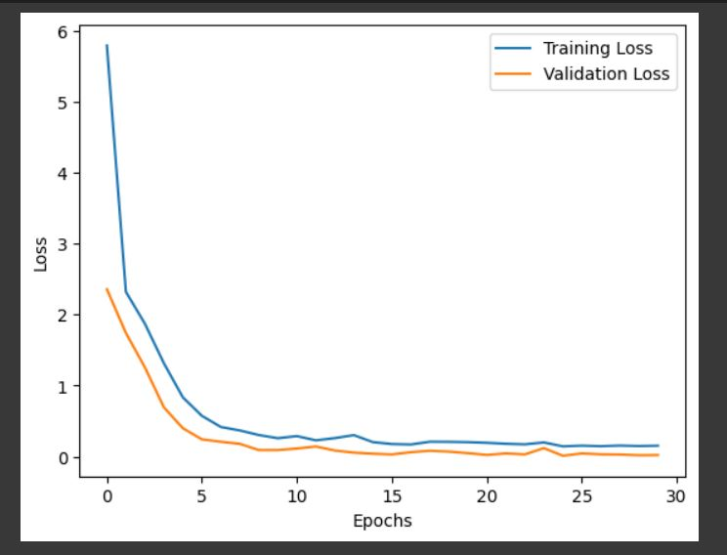
LOSS & ACCURACY PLOTTING
Accuracy and validation
Loss and validation

Slide 9
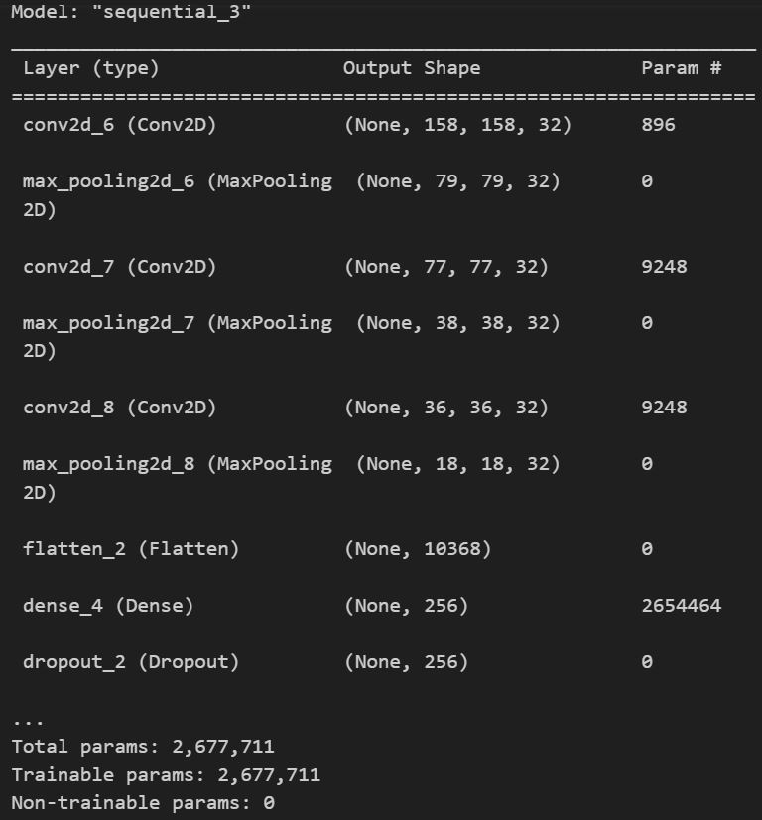
MODEL ARCHITECTURE

Slide 10
Similar Researchers
Two-Stream CNN
 | UFC101 | HMDB51 | HAR (Simple CNN)
(Simonyan,Zisserman,2014) | 52.8% | 46.6% | -
(Feichtenhofer, Pinz, Zisserman, 2016) | 88.0% | 59.4% | -
(Usman, Umair, Hamza, -) | - | - | 95.86%

Slide 11
References
Simonyan, K., & Zisserman, A. (n.d.). Two-Stream Convolutional Networks for Action Recognition in Videos.
Feichtenhofer, C., Pinz, A., & Zisserman, A. (n.d.). Convolutional Two-Stream Network Fusion for Video Action Recognition. https://github.com/feichtenhofer/twostreamfusion

Slide 12


